Slide 1
Interacting with the Linux Shell
1
Interacting with the Linux Shell

Slide 2

Interacting with the Linux Shell
1
Interacting with the Linux Shell

Slide 3
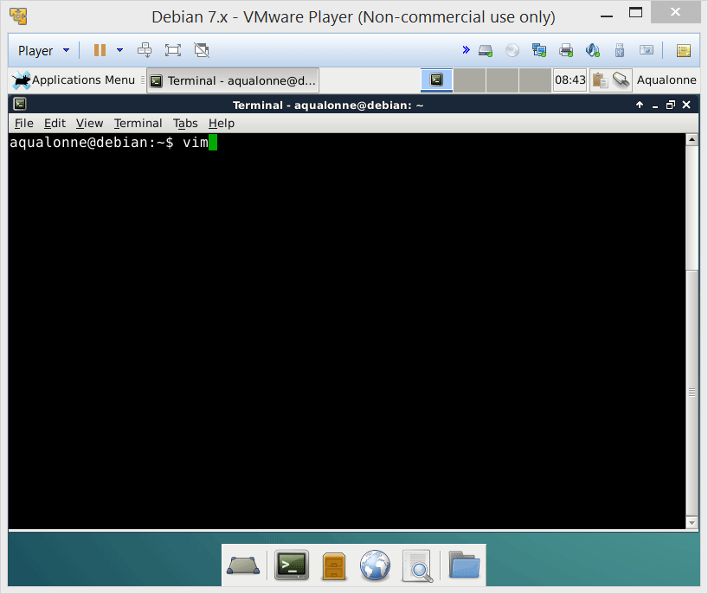
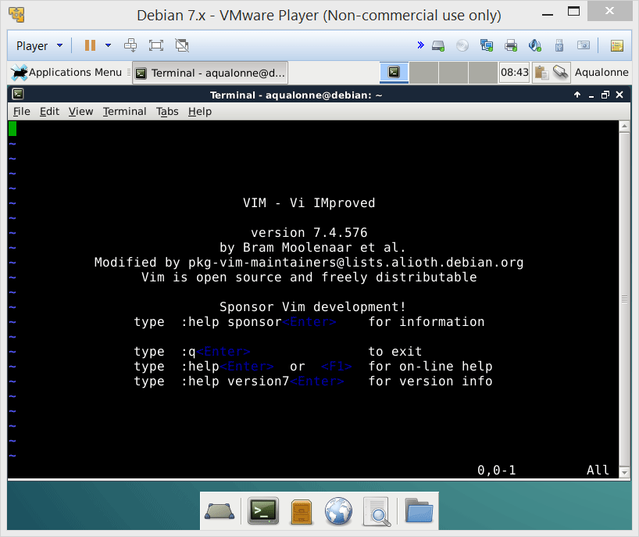
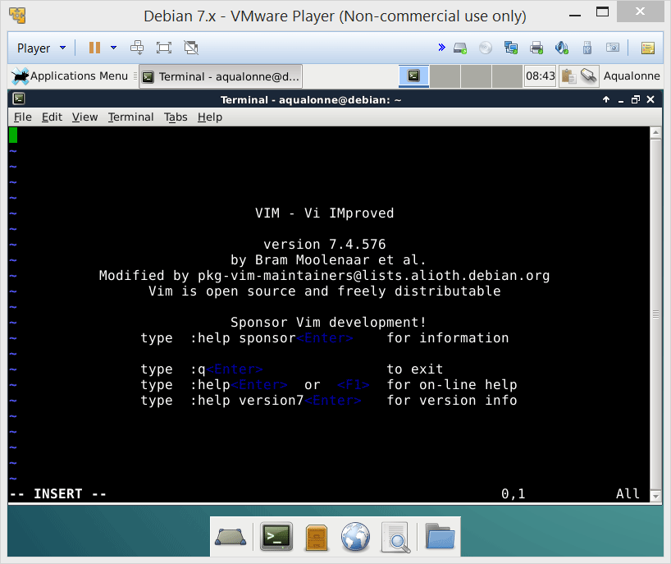
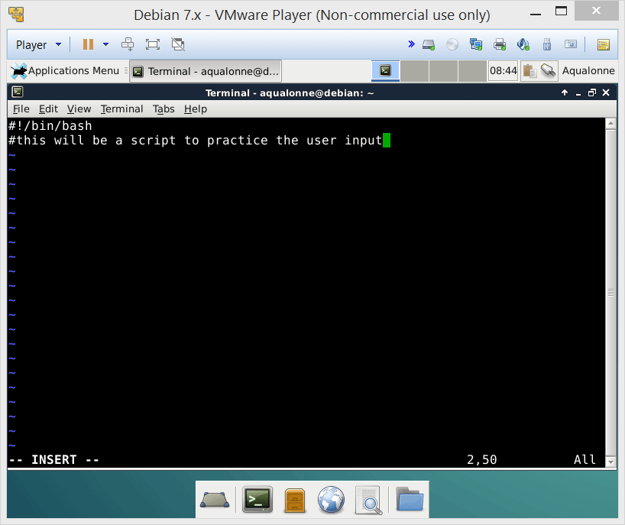



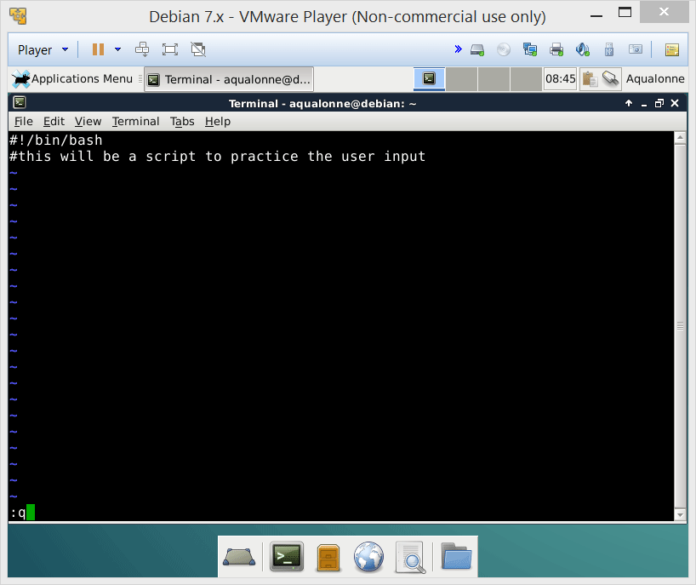
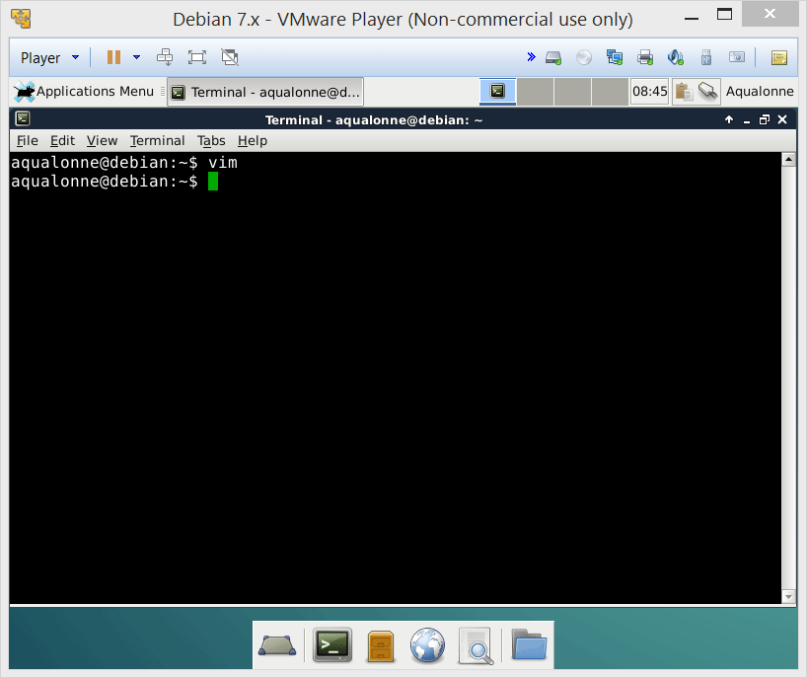
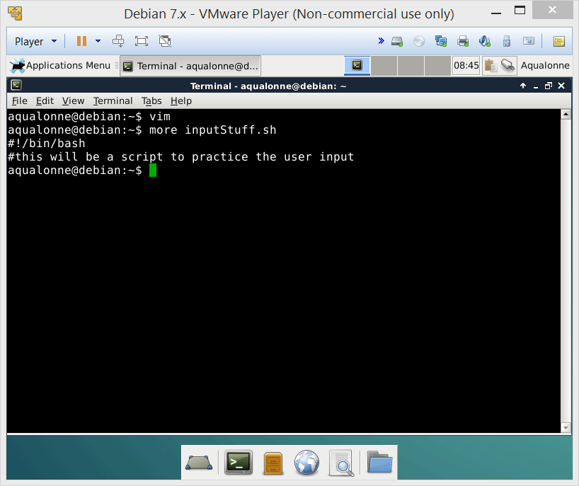
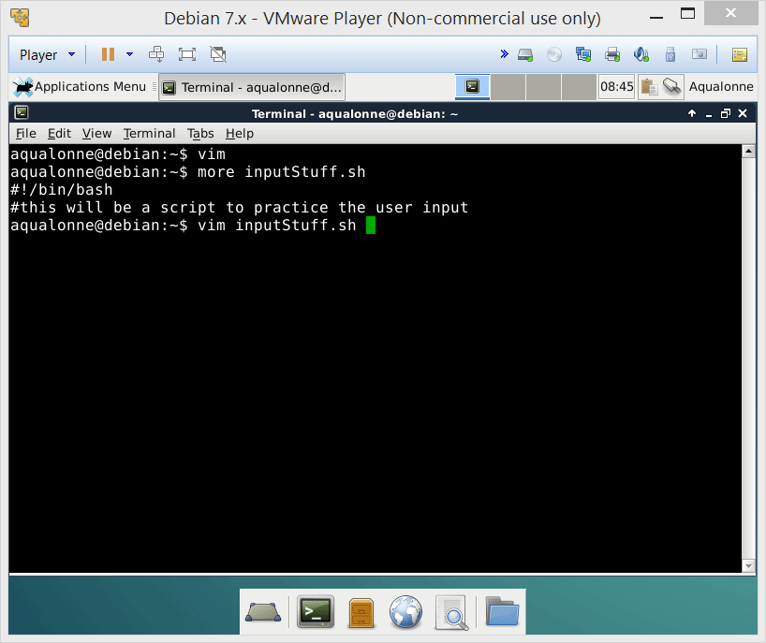

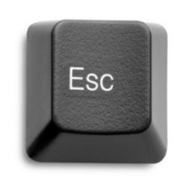
Our editor for this module: vim
To write, press a
To stop writing, press
To quit type
:q
To write the file (=save) type
:w
Any command starts with
:
2
Interacting with the Linux Shell

Slide 4
Getting the user’s input
read [-p “prompt”] variable [more variables]
Stores the first word entered by the user
The 2nd variable stores the 2nd word (if applicable), etc.
The last variable stores what remains
3
Interacting with the Linux Shell

Slide 5
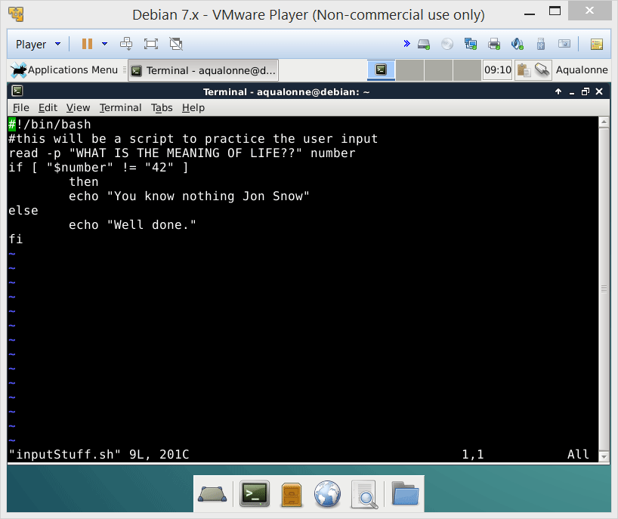
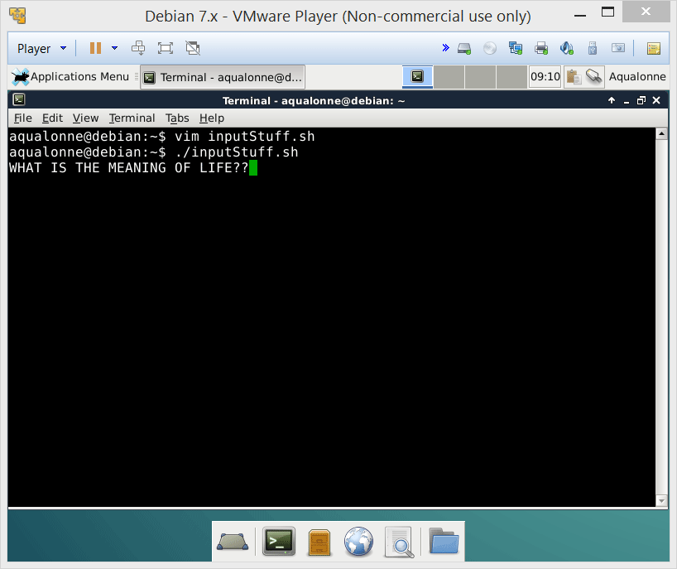

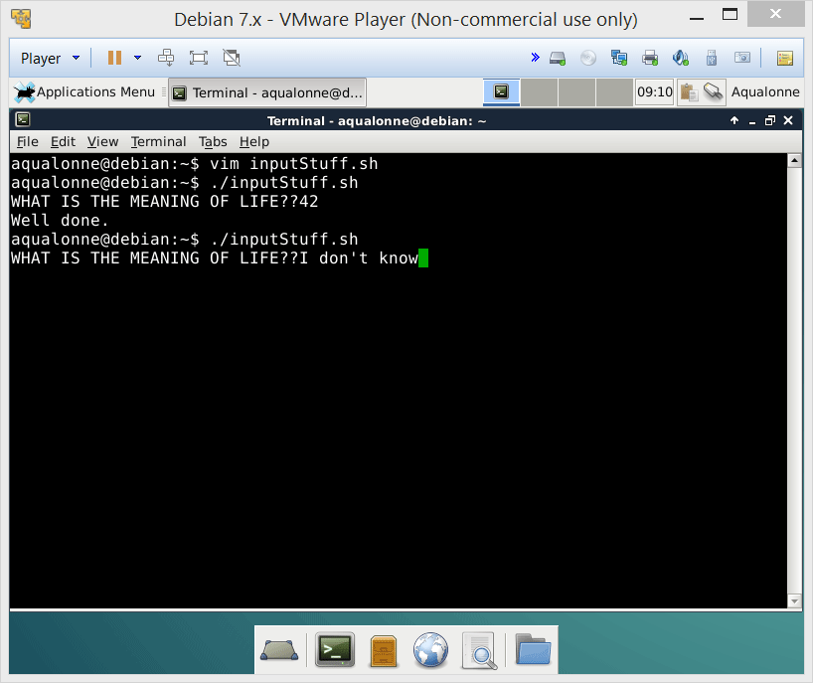




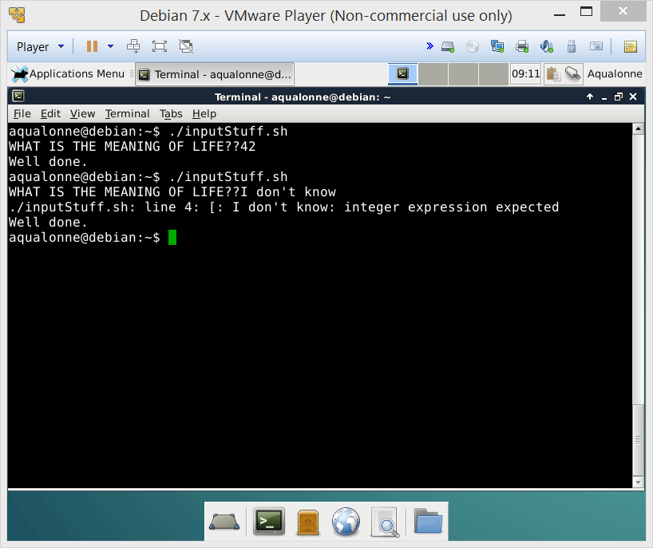
Getting the user’s input
Always assume that the user could write anything
If you are going to compare their input, then either
(1) Compare with a string
or
(2) Handle type errors
2>/dev/null
4
Interacting with the Linux Shell

Slide 6

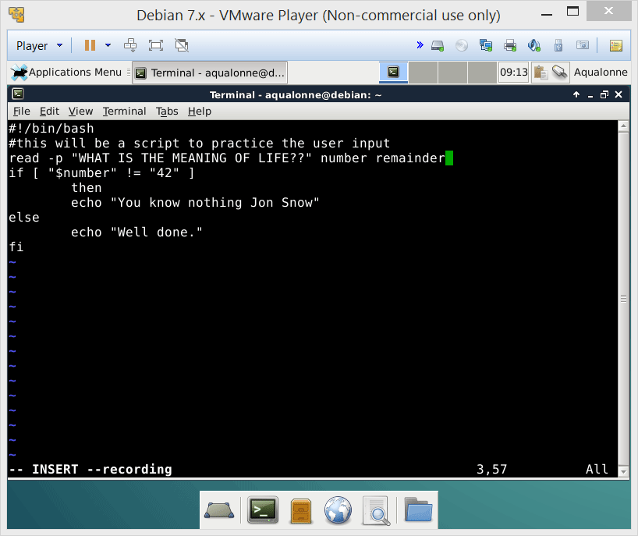
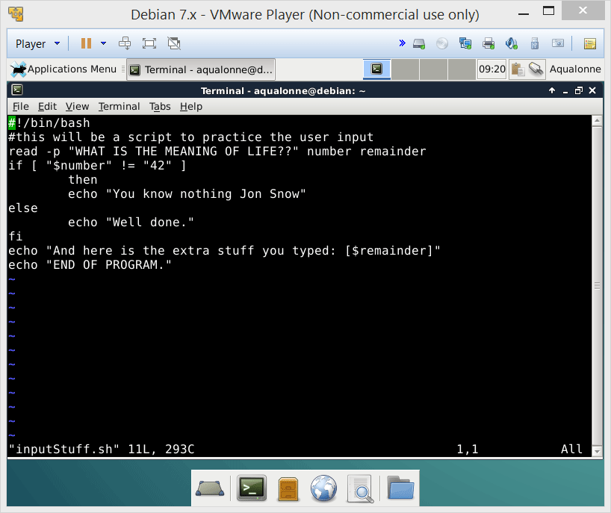
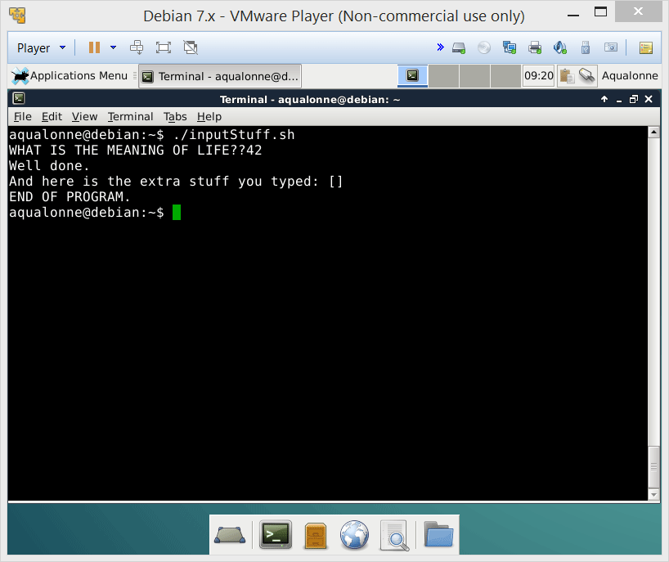
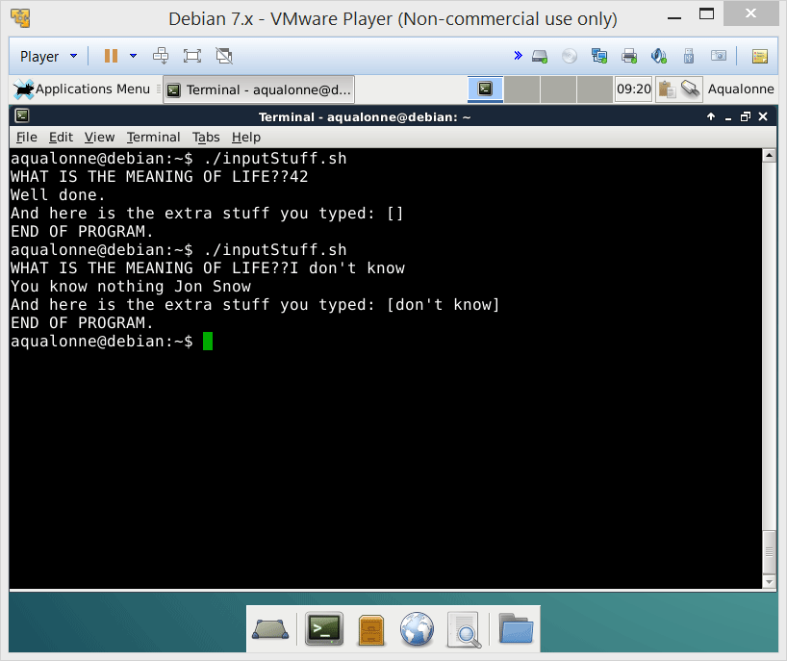
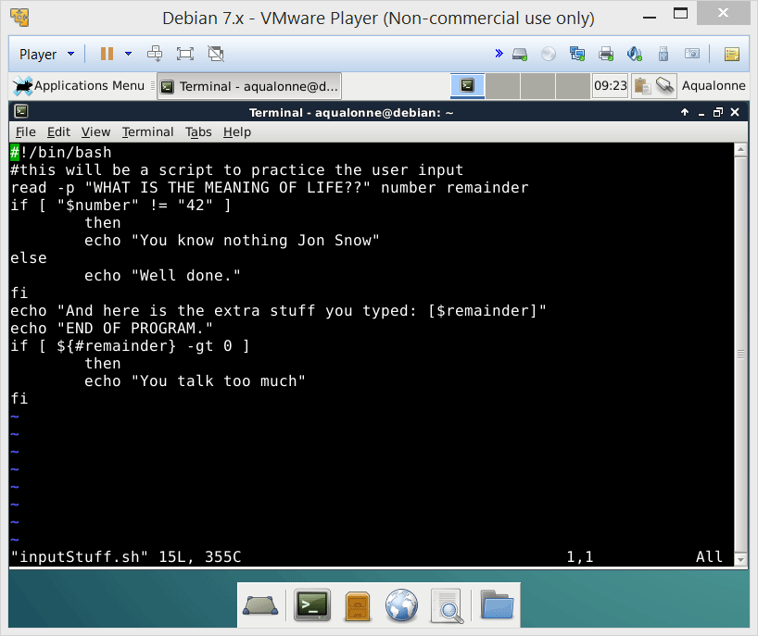

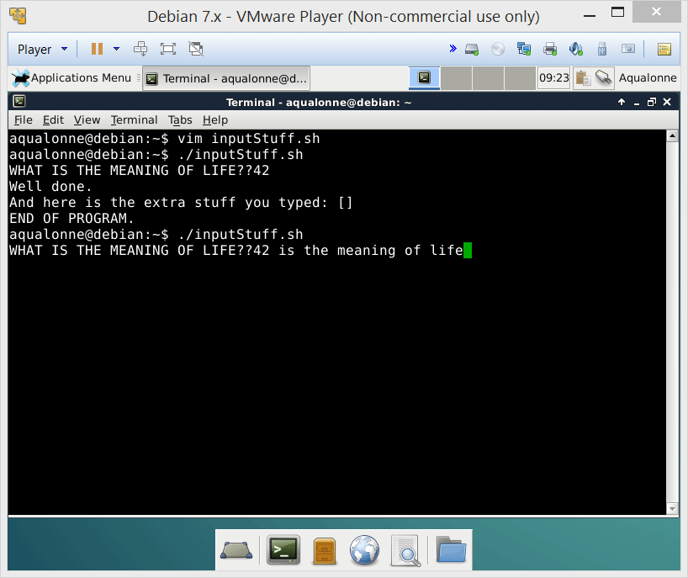
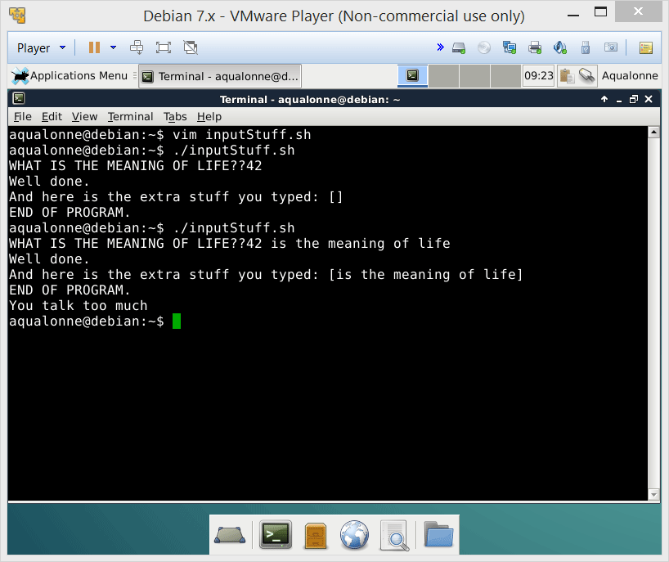
Getting the user’s input
If it matters whether the user typed more stuff, add a variable and check its content
${#X}
gives you the length of string X
5
Interacting with the Linux Shell

Slide 7




Multiple cases
If you only have 2 outcomes, if-else is the right structure. But when you have more...
case
if
if
else
if
else
else
6
Interacting with the Linux Shell

Slide 8
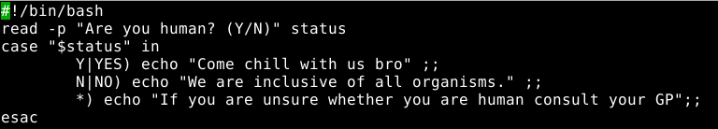
Multiple cases
If you only have 2 outcomes, if-else is the right structure. But when you have more...
case
case “$variable” in
pattern1) action1 ;;
pattern2) action2 ;;
...
patternN) actionN ;;
esac
All patterns are accepted: a single word (42), one word or another (42 | 41), words starting with a specified string (fourty*), etc.
As in an if, you can write anything as action.
7
Interacting with the Linux Shell

Slide 9
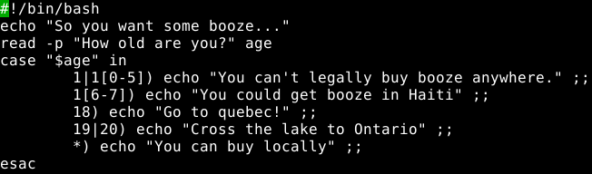
Multiple cases
If you only have 2 outcomes, if-else is the right structure. But when you have more...
case
case “$variable” in
pattern1) action1 ;;
pattern2) action2 ;;
...
patternN) actionN ;;
esac
All patterns are accepted: a single word (42), one word or another (42 | 41), words starting with a specified string (fourty*), etc.
As in an if, you can write anything as action.
8
Interacting with the Linux Shell

Slide 10

Display information the nice way
You don’t want to overwhelm the user with lots of dirty-looking output.
echo does display but it’s very basic.
printf can display nicely.
The print statement allows you to state how much of a variable you want to see.
printf “text %.3f text %.2f text %s“ $variable1 $variable2 $variable3
How many digits you want to see after the .
0.59275610
Printing my deposit with 4 digits after the .
printf "deposit %.4f“ $deposit
9
Interacting with the Linux Shell

Slide 11
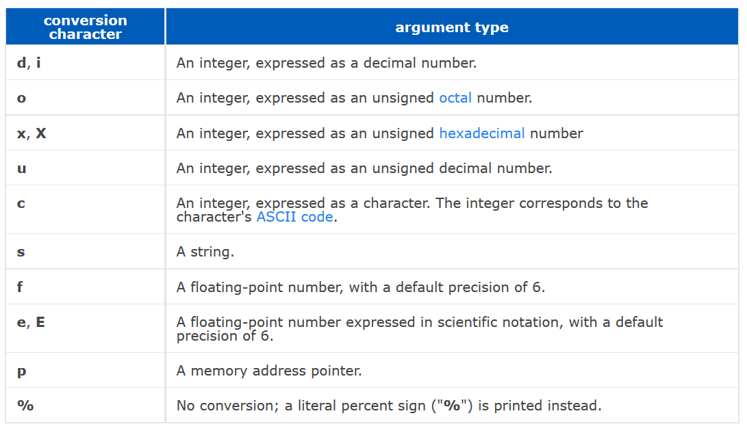
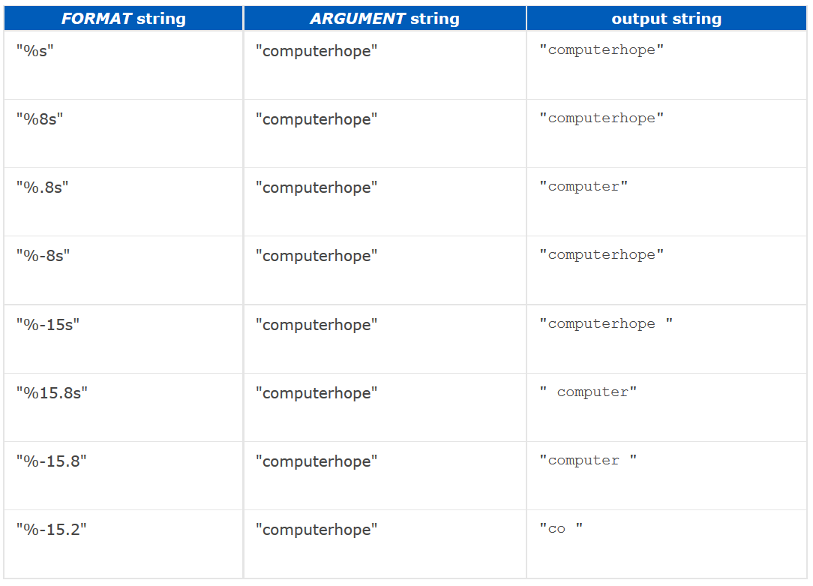
Display information the nice way
(for more info, read the man page or http://www.computerhope.com/unix/uprintf.htm)
10
Interacting with the Linux Shell

Slide 12

11
Interacting with the Linux Shell

Slide 13

Practice questions & activities
We recommend that you do these, but that’s for your own good, not graded.
Ask the user what’s their favourite season and give a reply accordingly
Ask the user what’s their annual income and give them their tax bracket.
12
Interacting with the Linux Shell

